Slide 1


ADSP 31006 IP01
Time Series Analysis and Forecasting
Forecasting
Human Development Index Trends in the
Middle Eastern Countries
A Time Series Analysis
Group 8
Aiman Al-Toubi (aimanaltoubi@uchicago.edu)
Arpan Pradhan (arpan1@uchicago.edu)
Astari Raihanah (astari@uchicago.edu)
Surya Hardiansyah (sur@uchicago.edu)

Slide 2

The Importance of the Human Development Index (HDI)
Composite Index: Life expectancy, education, and per capita income
Idea: Ranks countries in the ordinal scale of human development.
Significance: Guides policy, resource allocation, and progress monitoring
Business case and problem statement
3/24
Notes:
Background story

Slide 3
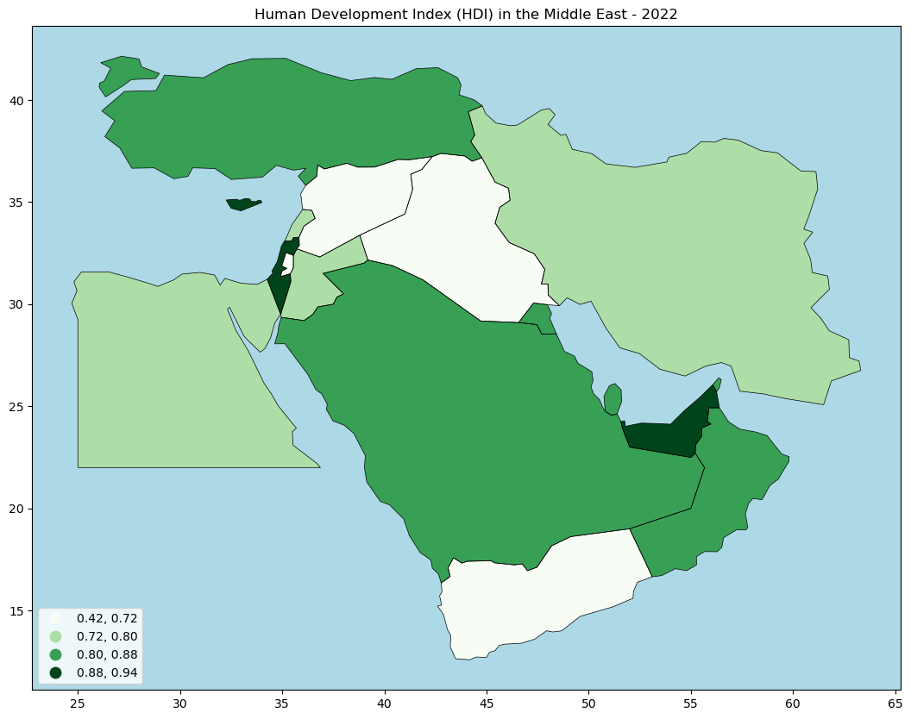
Business Case: The Middle East, a Region of Contrasts
Challenges: political instability, economic disparities, and varying levels of development.
"How can we predict the future to build a better tomorrow?"
Business case and problem statement
4/24
Notes:
Business case

Slide 4

Problem: Predicting to Inform Policy
01.
Data limitations
02.
Non-stationarity
Business case and problem statement
5/24
Notes:
Problem statement

Slide 5


Null Hypothesis (H₀)
Time series forecasting models applied to HDI data will not significantly improve the accuracy of predicting future human development trends in Middle Eastern countries compared to a baseline model or random predictions.
Alternative Hypothesis (H_{A})
Time series forecasting models applied to HDI data will significantly improve the accuracy of predicting future human development trends in Middle Eastern countries compared to a baseline model or random predictions.
Modeling hypothesis and assumptions
6/24
Notes:
Modeling hypothesis

Slide 6
Assumptions:
Time series data has stationarity
Selected features are sufficient for forecasting
Historical HDI data are reliable as a future trend predictor
Modeling hypothesis and assumptions
7/24
Notes:
Modeling assumptions

Slide 7

Applying Time Series Models
01.
Accurately predict HDI trends
02.
Provide actionable insights for policymakers
Modeling hypothesis and assumptions
8/24
Notes:
Assumed result

Slide 8

Data Processing and EDA
10/24
Notes:
Data processing and EDA

Slide 9
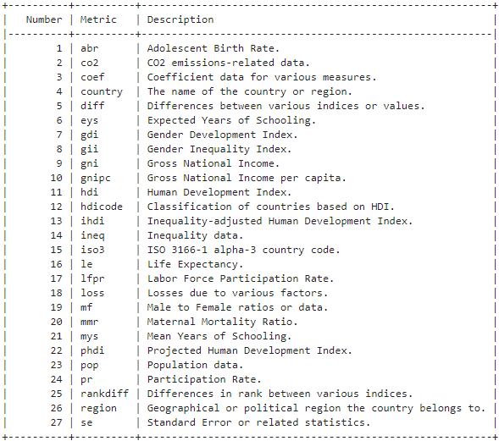
Data description
https://hdr.undp.org/sites/default/files/2023-24_HDR/HDR23-24_Composite_indices_complete_time_series.csv
Various socio-economic indicators for countries worldwide, 1990 - 2022
1076 columns (27 unique time variant metrics): demographic, economic, educational, and health-related metrics
Data description and properties
9/24
Notes:
Data description and properties

Slide 10
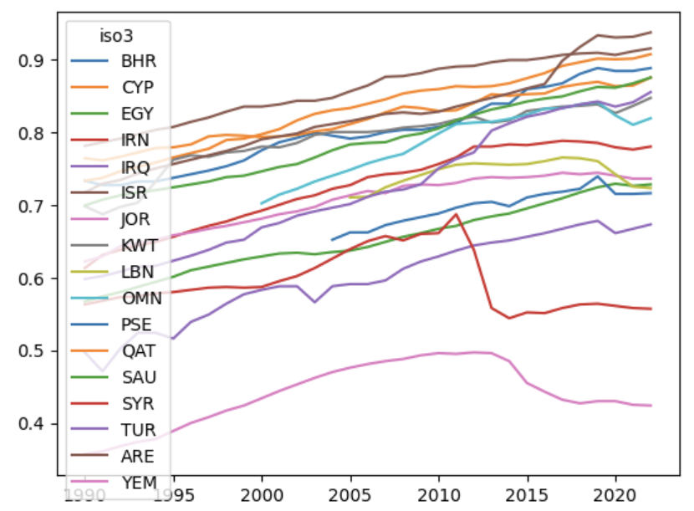
Series Overview
The nature of the series of the data is mixed between seasonal and trend depending on the country
For the HDI data itself, several countries (e.g., Oman, Lebanon, and Palestine) have an incomplete HDI data especially in the earlier years of dataset.
Data processing and EDA
11/24
Notes:
Data description and properties

Slide 11
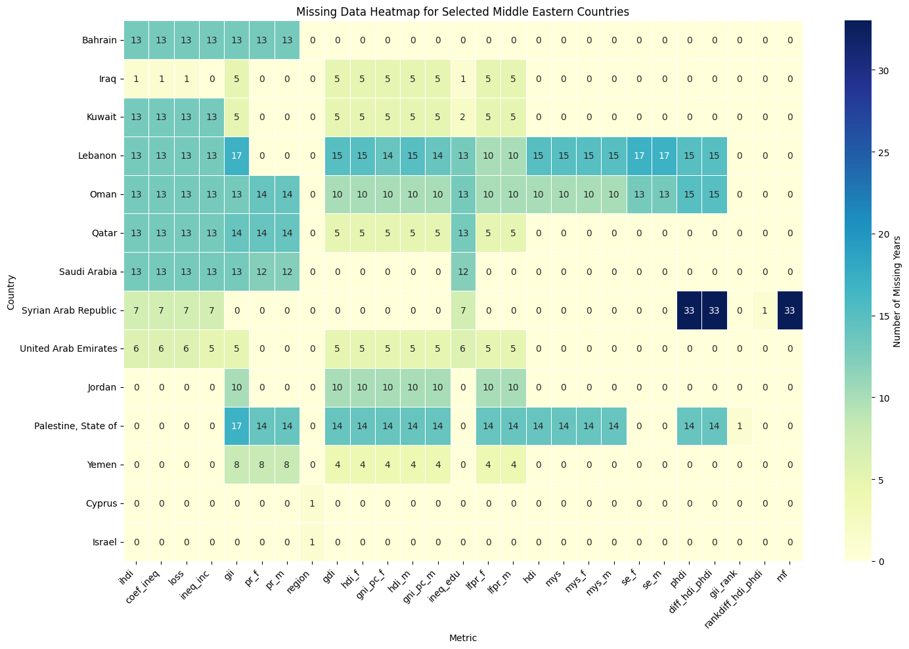
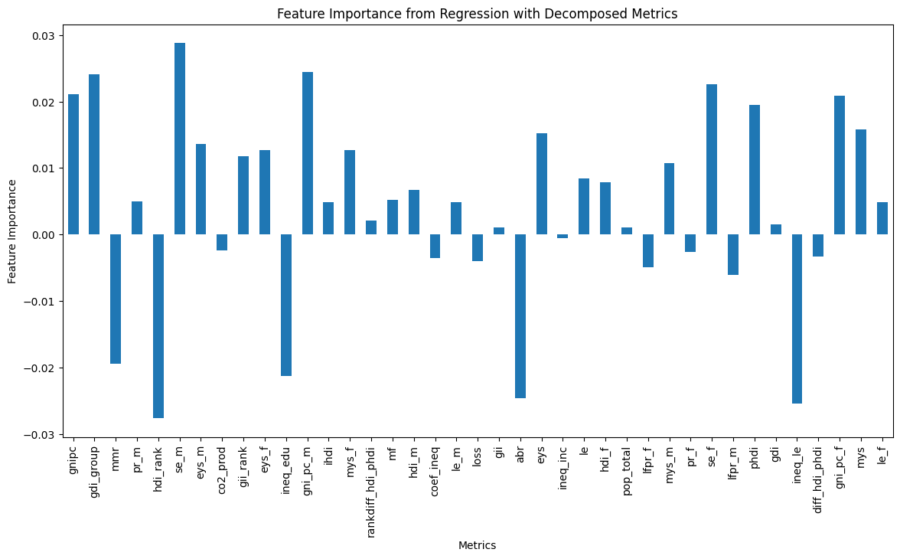
Missing Values and Feature Importance
Following features had fewer missing values and strong HDI correlation were chosen such as Mean Years of Schooling, Gross National Income per Capita, and Difference Between HDI and Potential HDI.
Regression as a component was used to do feature importance in order to check what other metrics in the data influence HDI.
Data processing and EDA
11/24
Notes:
Data description and properties

Slide 12
Feature Engineering
Data Preparation
Data Transformation
Train-Test Split
Extract and Subset the Data into Middle Eastern Countries
Handling Missing Data using mean imputation
Transforming the Data when it’s necessary (e.g., Differencing, Log Transformation, etc.)
To maintain the chronological order
Avoid data leakage
Creating Lagged Features
Data Reshaping for ML Algorithms
Creating lagged features (hdi_lag1)
Capturing Autocorrelation in Time Series Data
Some ML Algorithms require data in long format to correctly model the relationships over time.
Feature Engineering
12/24
Notes:
Feature egineering

Slide 13
Proposed Modeling Approaches
13/24
Notes:
Data processing and EDA

Slide 14



Proposed Modeling Approaches
Auto ARIMA
Facebook Prophet
H2O AutoML
Proposed modeling approaches
14/24
Notes:
Proposed modeling approaches

Slide 15
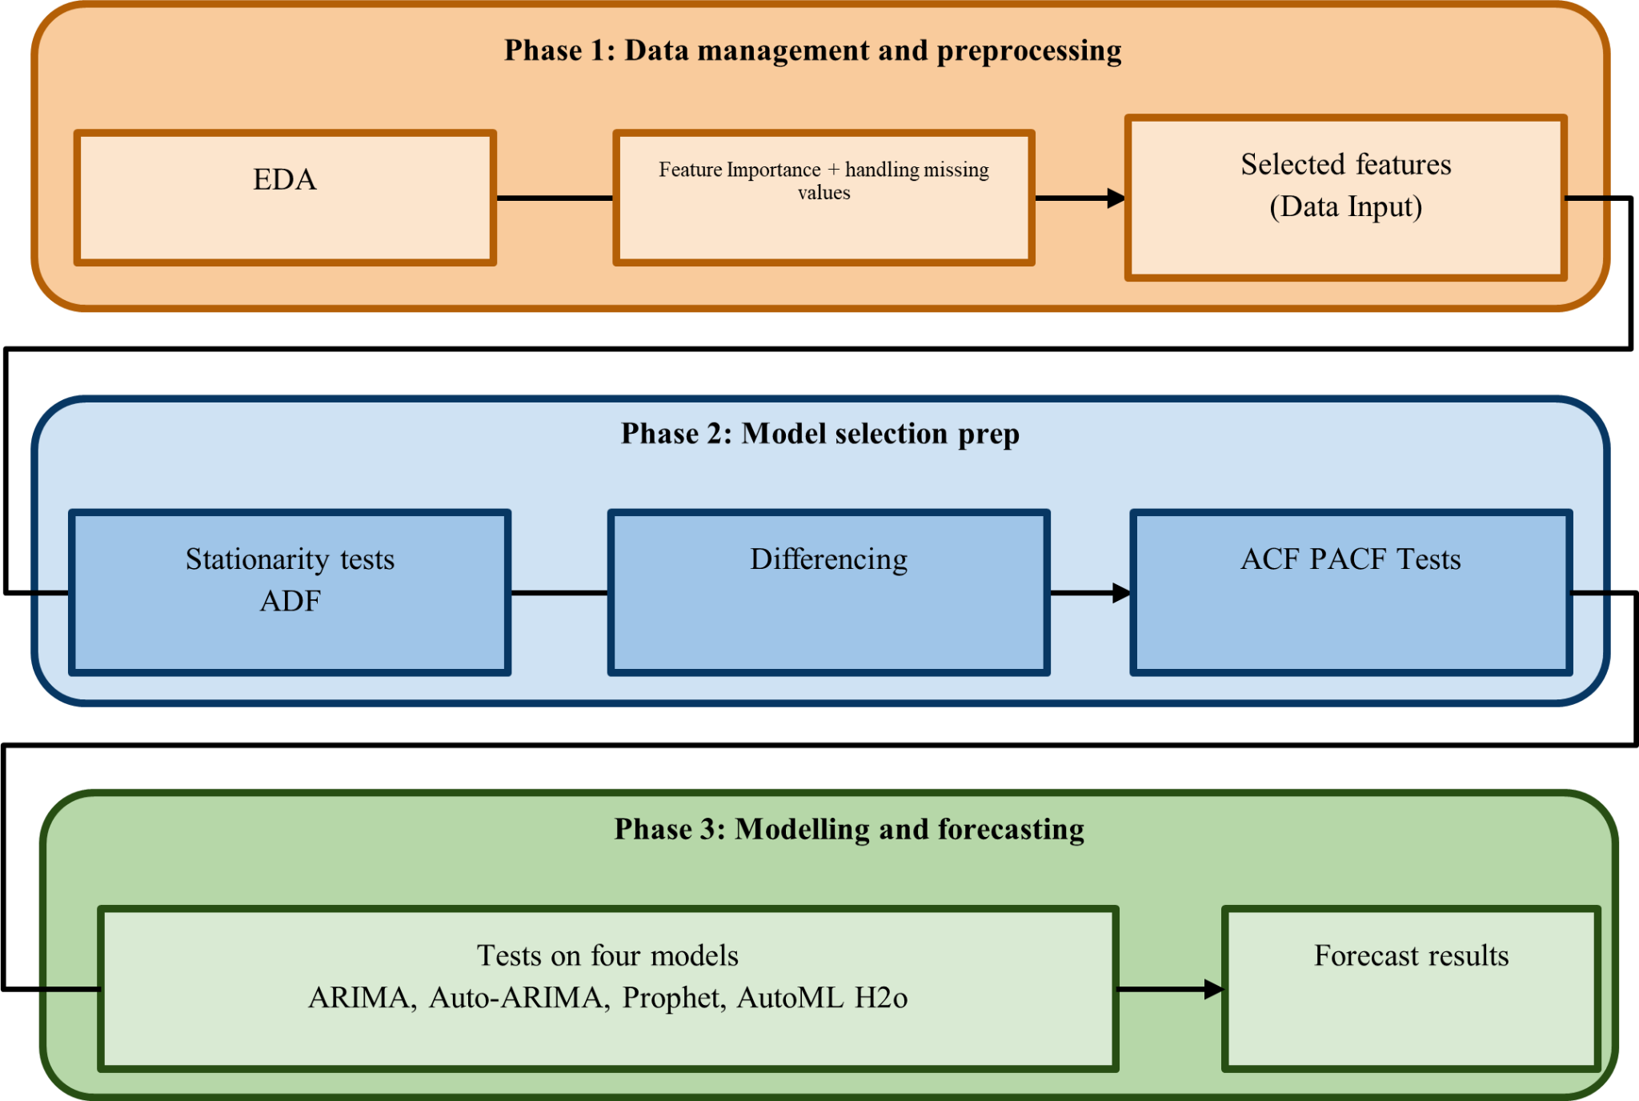
15/24
Notes:
Process flow

Slide 16
Selected Modeling Results with Justifications and Tradeoffs
16/24
Notes:
Data processing and EDA

Slide 17
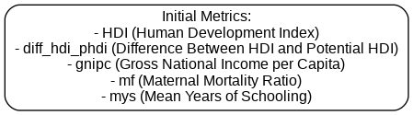
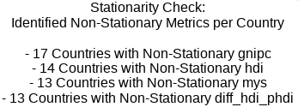
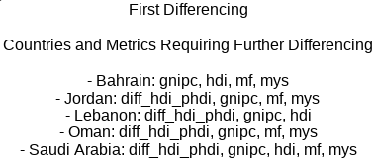
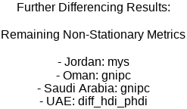
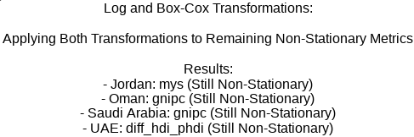
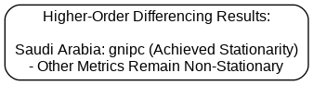
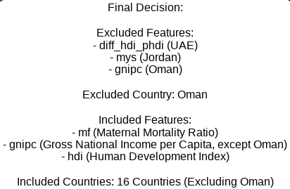
Stationarity Evaluation Results
1
2
3
ADF and KPSS tests
4
5
6
7
Selected model results with justifications and tradeoffs
17/24
Notes:
Selected model results (justifications and tradeoffs)

Slide 18
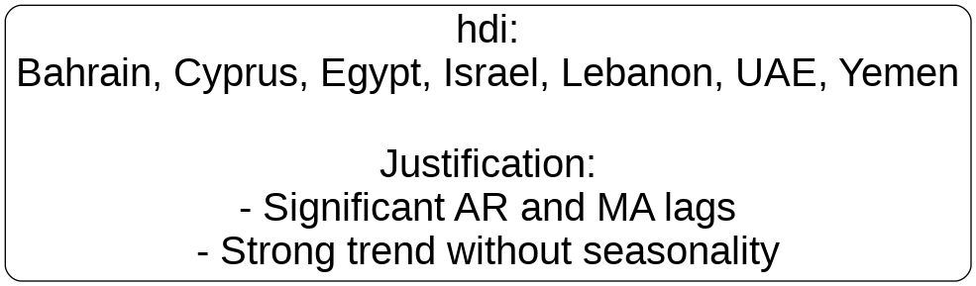
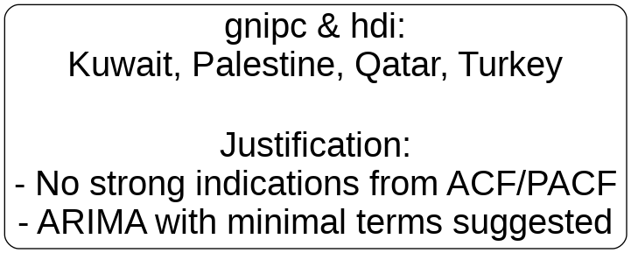
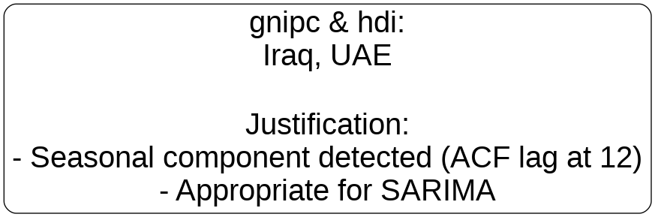
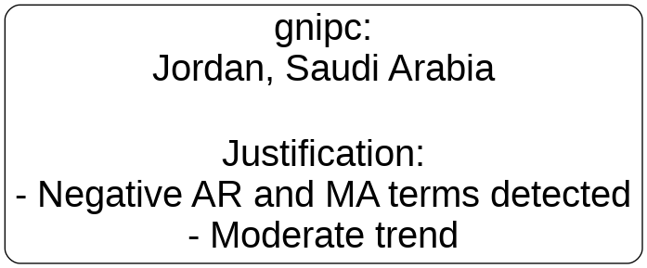



ACF and PACF evaluation of results
Selected model results with justifications and tradeoffs
17/24
Notes:
Selected model results (justifications and tradeoffs)

Slide 19
Model Results Comparison
1
2
3
Univariate Linear Facebook Prophet
AutoML H2O (Stacked Ensemble)
Auto-ARIMA
R-squared: -0.8460
MAE: 0.0063
MSE: 9.7939
RMSE: 0.0098
R-squared: 0.9537
MAE: 0.0188
MSE: 0.0006
RMSE: 0.0263
R-squared: 0.99
MAE: 0.0046
MSE: 3.80
RMSE: 0.0061
Poor R2 and MSE results
Better R2 but worse MAE and RMSE results
Better MAE, R2 but worse MSE results
Selected model results with justifications and tradeoffs
19/24
Notes:
Selected model results (justifications and tradeoffs)
The one who is doing the Auto ARIMA is … Astari in her own work

Slide 20
Insights / recommendations
& Future work
20/24
Notes:
Data processing and EDA

Slide 21
Challenges and Insights
Data quality and availability
Inconsistent or missing HDI data across some countries.
Model Selection and parameter tuning
1
Identifying optimal model parameters, especially for diverse data patterns.
Handling Non-Stationary Data
Managing complex differencing requirements without overfitting.Apply regularization techniques.
2
Future Forecasting
3
Adapting models to evolving HDI trends and data availability.Continuously update models with new data and insights, and refine strategies to ensure accurate and relevant predictions.
4
Insights/Recommendations & Future Work
21/24
Notes:
Challenges/Insights

Slide 22
Recommendations
Continuously Update Models
Regularly refine models with new data to maintain relevance and accuracy in predictions.
Handling Structural Breaks and Political Instability
Due to volatility in the Middle Eastern region due to political events and economic reforms, we need to account for sudden shifts that could otherwise distort forecast.
.
05
01
04
Long-Term Strategic Planning
We recommend conducting scenario analysis using the SARIMA model to explore how different policy decisions might impact HDI over time.
02
03
Addressing Data Quality and Gaps
Inconsistent data collection practices and missing data points pose significant challenges. We recommend working with local governments and international organizations to standardize data collection and fill in any gaps.
Model selection and Implementation
SARIMA model, combined with external regressors such as GDP, education expenditure, and healthcare spending, provides a more nuanced and accurate forecast of HDI.
Insights/Recommendations & Future Work
22/24

Slide 23
Future Work
Implement automated model selection and hyperparameter tuning to optimize forecasting performance.
Create pipelines for real-time data integration and forecasting , enabling timely decision making .
Explore the integration of machine learning models such as XGBoost, Random Forests, and Long Short-Term Memory (LSTM) networks.
Enhance Data and Predictors
Advanced Modeling Techniques
Hyperparameter Tuning
Exploring External Factors and Multivariate FOrecasting
Vestibulum congue
Vestibulum congue
Vestibulum congue
Vestibulum congue
Exploration of Alternative Data Sources
Handling Non-Stationarity and Structural Breaks
Insights/Recommendations & Future Work
23/24
Notes:
future work

Slide 24

Thank you
very much!
Any questions?
Notes:
closing

